Slide 1

Bioinformatics of SARS-CoV-2 – Quality Control (QC) of sequences
San James, Houriiyah Tegally, Centre for Epidemic Response and Innovation (CERI), STIAS Conference Venue, Stellenbosch University, South Africa.

Slide 2
Outline
Understanding your consensus sequence data
Quality Control of consensus sequences
What constitutes quality issues?
How to use Nextclade and AliView to clean consensus sequences?
Practical example
Calculating sequence coverage
Identifying quality issues
Cleaning sequencing to generate final consensus sequence

Slide 3
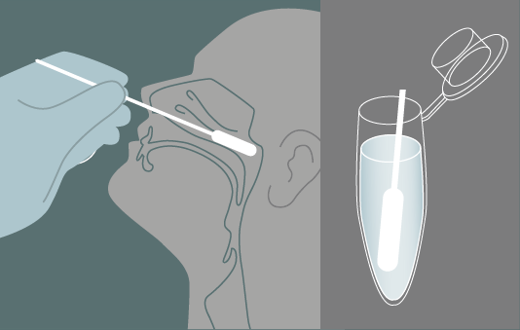
Data Production Workflow
Genome Assembly
Consensus Sequence QC
GISAID Submission
Sequencing
Short reads
FastQ files
Assembled whole-genomes (Fasta)
High quality genomes
Publicly available sequences

Slide 4
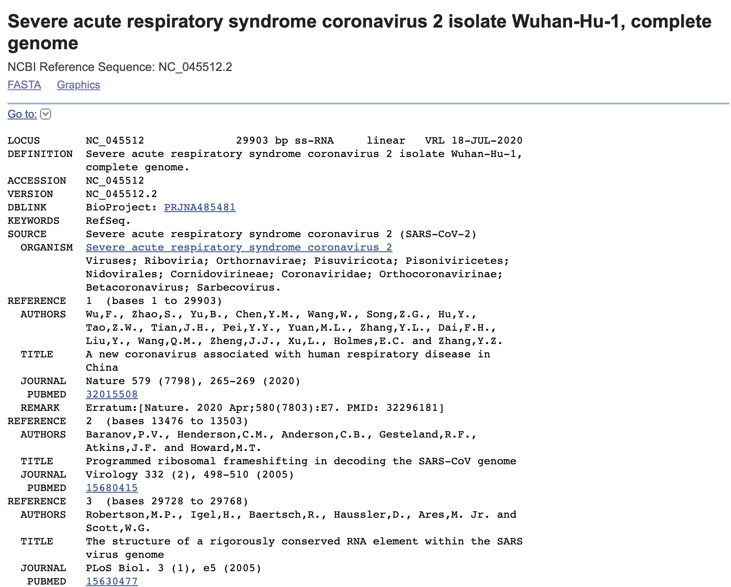
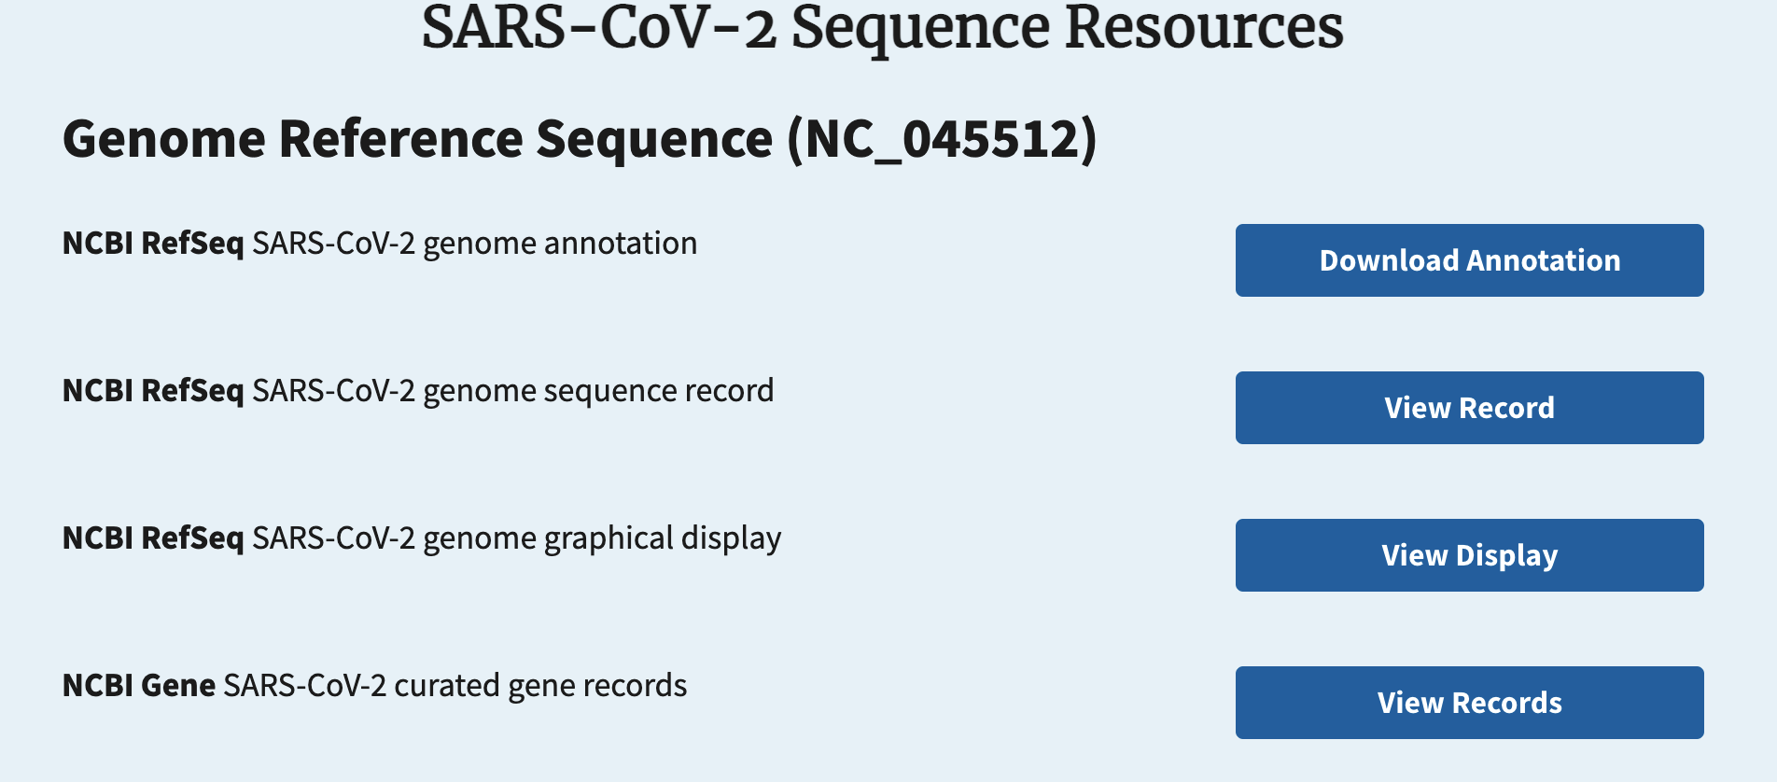
SARS-CoV-2 Reference Sequence
https://www.ncbi.nlm.nih.gov/sars-cov-2/

Slide 5


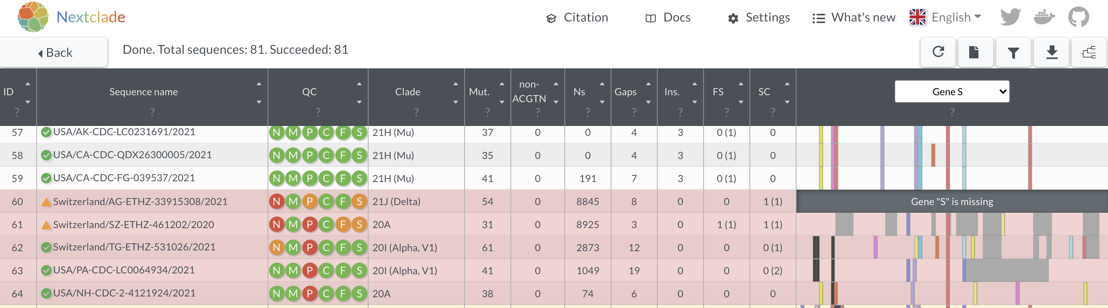
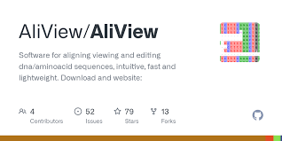
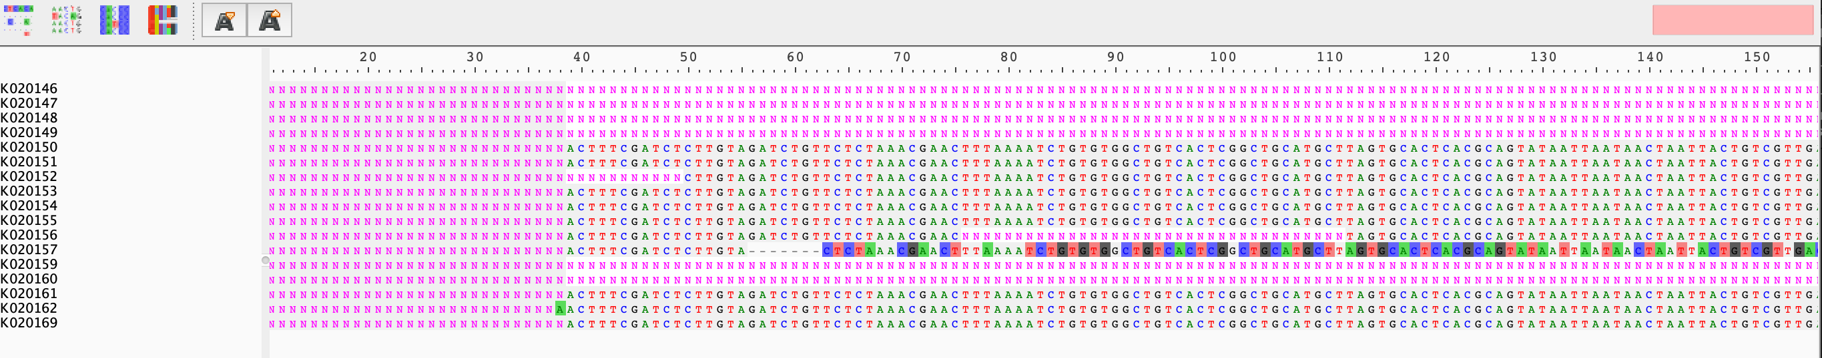
Understanding your sequence data
1.
Online program which performs alignment to the reference, clade assignment, reports mutation, and performs sequence quality checks
2.
Alignment viewer which allows you to visualize your sequences against one another

Slide 6
Understanding your sequence data
1.
Quality control check:
Missing data (N): >3000 Ns: flagged as bad
Mixed sites (M): Too many ambiguous nucleotides (non-ACTGN - R, Y, etc): contamination (or superinfection)
Private mutations (P): Too many mutations relative to the reference (Threshold changes over time)
Mutation clusters (C): Clusters of 6 or more mutations within 100-nucleotide window
Stop codons (S): Replicating viruses can not have premature stop codons in essential genes, excluding known stop codons for functional viruses
Frame shifts (F): Frame shifting insertions or deletions distorts translation (Note: clade 21H has a frame shift towards the end of ORF3a that results in a premature stop)
Interpretation: Does not mean sequences are problematic, but issues need closer examination.

Slide 7
Understanding your sequence data
1.
Clade assignment:
Lightweight approach which assigns sequences to clades by placing sequences on a phylogenetic tree annotated with clade definitions by quickly comparing mutations to an existing reference tree.
Not the most accurate phylogenetic placement but gives quick and good results!
Genome viewer
Showing coverage of whole genome or specific genes on the genome and location of mutations
Download results
Number of nucleotide mutations against the reference

Slide 8
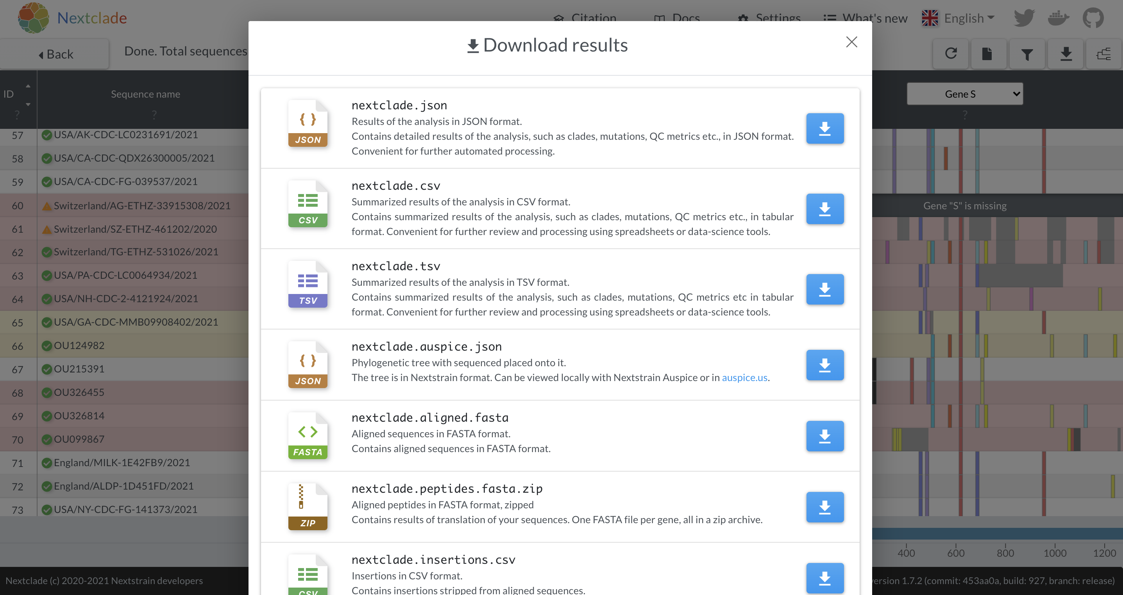
Understanding your sequence data
Tabulated results with clade assignment, quality checks, mutations, etc
Fasta file of sequences that have been aligned to the reference

Slide 9
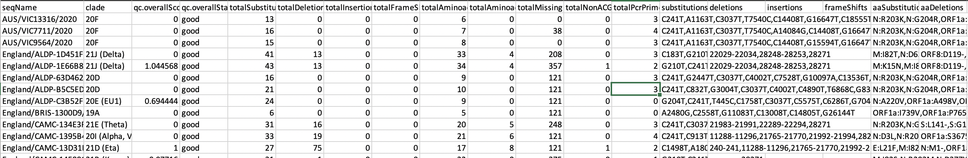
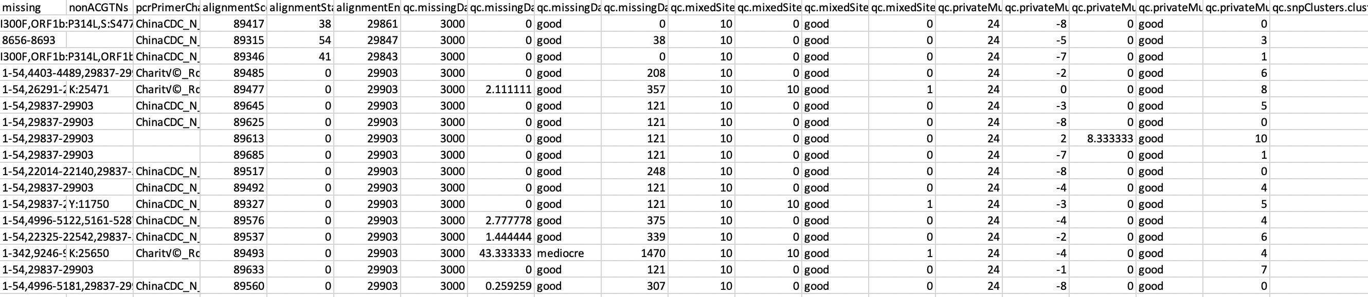
Understanding your sequence data

Slide 10
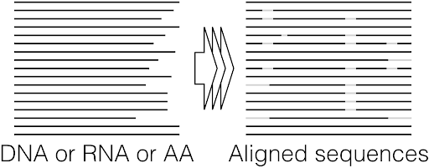
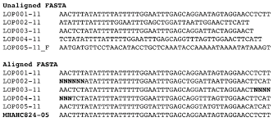
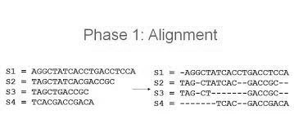
Understanding your sequence data
Difference between unaligned and aligned sequences
Sequence alignment is a way of arranging the sequences of DNA, RNA, or protein to identify regions of similarity and infer evolutionary relationships between the sequences.

Slide 11
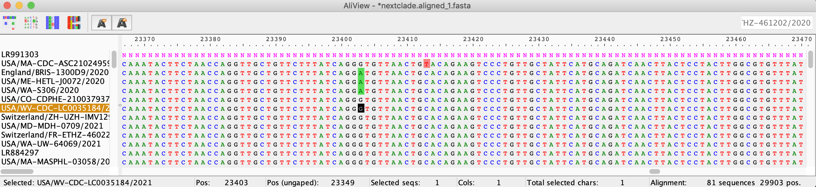
Understanding your sequence data
2.
Alignment viewer which allows you to visualize your sequences against one another
Best to view aligned sequences
Your sequences can be easily aligned and downloaded with nextclade (nextclade.aligned.fasta)
The sequences that you visualize on AliView can be manually editted with the keyboard
Nucleotide position on genome
Mutations
Number of sequences in fasta file/alignment
Selected sequence name
Position of selected nt
Selected nt base
Length of alignment

Slide 12
Quality Control (QC) - Sequences
What constitutes quality issues?
Low genome coverage
Indels not a multiple of 3 (i.e. frameshifting)
Mutations causing premature stop codons
Very large indels
Clustered SNPs

Slide 13
Sequence Coverage
Whole genome of SARS-CoV-2 = 29903 nt bases
Sequence Coverage (length): What % of the whole genome was successfully sequenced?
Calculating sequence coverage % from nextclade results
Length of genome with sequencing data
= alignmentEnd – alignmentStart – totalMissing
% coverage relative to reference =
= ((alignmentEnd – alignmentStart – totalMissing)/29903)*100
Sequences of >90% are considered near-whole-genome
You may want to discard sequences of <80% or <90% coverage to keep analysis to the highest level
However, sequences of lower coverage may not be completely useless

Slide 14
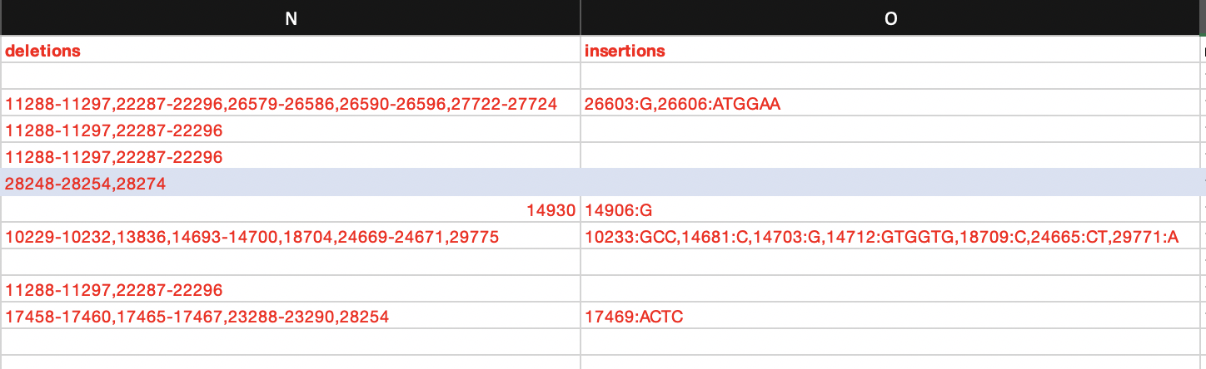
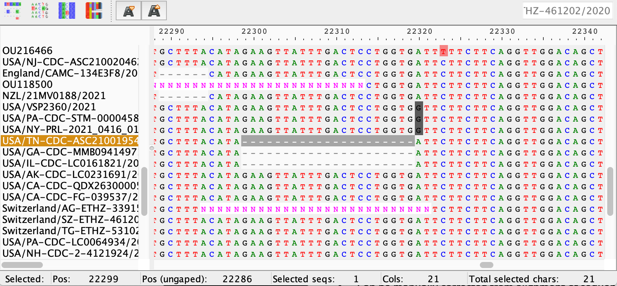
Indels
- Insertion–deletion mutations (indels) refer to insertion and/or deletion of nucleotides into genomic DNA.
- Indels of length not a multiple of 3 must be checked and most probably corrected in the sequence (Frameshifts, i.e. potentially sequencing errors)
- Very large indels are also potentially sequencing errors and must be corrected
- Can be manually corrected from alignment of sequences with AliView by deleting an insertion or replacing a wrong deletion by a series of Ns
- Deletions of length a multiple of three can be kept

Slide 15
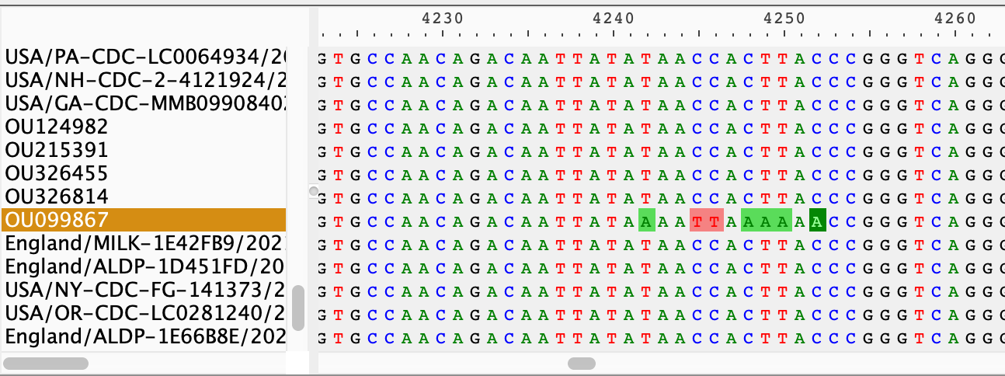
Clustered SNPs
Many nucleotide mutations that cluster together are indicative of a sequencing issue unless it is a known region of clustered mutations
seqName | qc.snpClusters.clusteredSNPs
OU215391 | 1-21:11
OU326814 | 21621-21626:7,29742-29795:9
OU326455 | 27555-27653:16,29769-29783:8
USA/GA-CDC-MMB09908402/2021 | 29666-29783:15
OU124982 | 29769-29779:8
OU099867 | 4242-4251:7,10431-10439:7,20677-20690:11,22591-22605:13,29772-29784:7
From Nextclade table:
Can be corrected by masking that region with a series of Ns

Slide 16
Let’s try!
Set-up:
Install AliView
https://ormbunkar.se/aliview/downloads/
Open Nextclade in a browser window
https://clades.nextstrain.org/
Download sample data
https://bit.ly/3o5tmy8
Install seqkit
https://bioinf.shenwei.me/seqkit/
Exercises:
Run your sequences through nextclade
Download the nextclade results table
Calculate their genome coverage
Identify sequences with frameshift indels
Download the aligned sequences from nextclade
View the alignment in AliView
Try to find regions of frameshift gaps or clustered mutations
Try to edit the alignment
Try to save the edited alignment as a new fasta file
Remove sequences of low coverage from your fasta file (in AliView or simple text editor)

Slide 17









Acknowledgements

